Slide 1

Data 603 – Big Data Platforms
Lecture 12
Optimization and Tuning

Slide 2
Viewing and Setting Configurations
Three ways to get and set Spark properties:
Through a set of configuration files
Within conf directory under $SPARK_HOME.
spark-defaults.conf, log4j.properties, spark-env.sh
Configuration changes in the conf/spark-defaults.conf file apply to the Spark cluster and all Spark applications submitted to the cluster.
Specify Spark configurations directly in the Spark application or on the command line when submitting the application with spark-submit, using the --conf flag.
Spark config settings can be accessed using SparkSession object
Through a programmatic interface via the Spark shell

Slide 3
Viewing and Setting Configurations
# Viewing Spark SQL-specific Spark configs
spark.sql("SET -v").select("key", "value").\
show(n=5, truncate=False)
spark.conf.get("spark.sql.shuffle.partitions")
spark.conf.set("spark.sql.shuffle.partitions", 5)
spark.conf.get("spark.sql.shuffle.partitions")

Slide 4
Configuration Precedence
An order of precedence determines which values are honored when setting Spark properties:
All values or flags defined in spark-defaults.conf will be read first
Configs supplied on the command line after that
Lastly, the configs set via SparkSession in the Spark application
All the properties will be merged. The properties specified in the Spark application takes the precedence. The value specified on the command line overrides the settings in the configuration file.

Slide 5
Scaling for Large Workloads
Sources of job failures:
Resource starvation
Gradual performance degradation
Spark Configurations can affect three components:
Spark Driver – responsible for coordinating with the cluster manager for resources and launch executors in a cluster and schedule Spark tasks to on them.
The executor
Shuffle service running on the executor

Slide 6
Dynamic Resource Allocation
Spark provides a mechanism to dynamically adjust the resources a Spark application occupies based on the workload.
The application may give resources back to the cluster if they are no longer used and request them again later when there is demand.
Useful:
Multiple applications sharing resources in a Spark cluster.
Streaming, where the data flow volume may be uneven
Data analytics, where there is high traffic of SQL queries during peak hours.

Slide 7
Dynamic Resource Allocation
spark.dynamicAllocation.enabled
Whether to use dynamic resource allocation, which scales the number of executors registered with this application up and down based on the workload.
By default, spark.dynamicAllocation.enabled is false.
spark.dynamicAllocation.minExecutors
Lower bound for the number of executors if dynamic allocation is enabled.

Slide 8
Dynamic Resource Allocation
spark.dynamicAllocation.schedulerBacklogTimeout
If dynamic allocation is enabled and there have been pending tasks backlogged for more than this duration, new executors will be requested.
spark.dynamicAllocation.maxExecutors
Upper bound for the number of executors if dynamic allocation is enabled.
spark.dynamicAllocation.executorIdleTimeout
If dynamic allocation is enabled and an executor has been idle for more than this duration, the executor will be removed

Slide 9
Executor’s memory and shuffle service
spark.executor.memory – determines the amount of memory available to each executor.
This is divided into three sections:
Execution memory (default: 60%), used for Spark shuffles, joins, sorts and aggregations.
Storage memory (default: 40%), primarily used for caching user data structures and partitions derived from DataFrames.
Reserve memory (default: 300 MB), safeguard against OOM errors.
When storage memory is not being used, Spark can take and use it in execution memory for execution purposes, and vice versa.

Slide 10
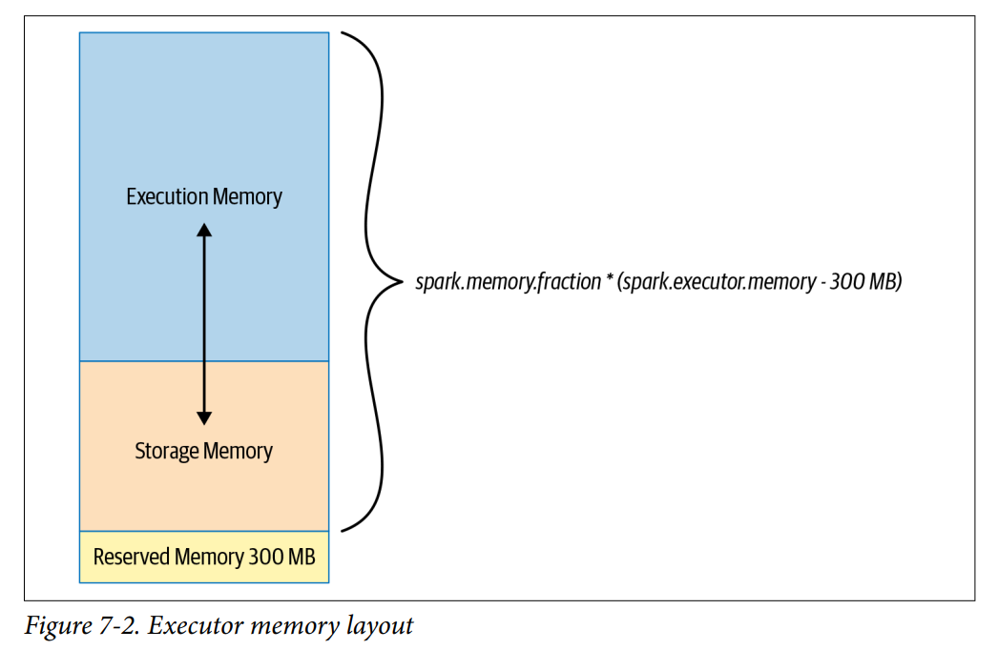
Executor’s memory and shuffle service

Slide 11
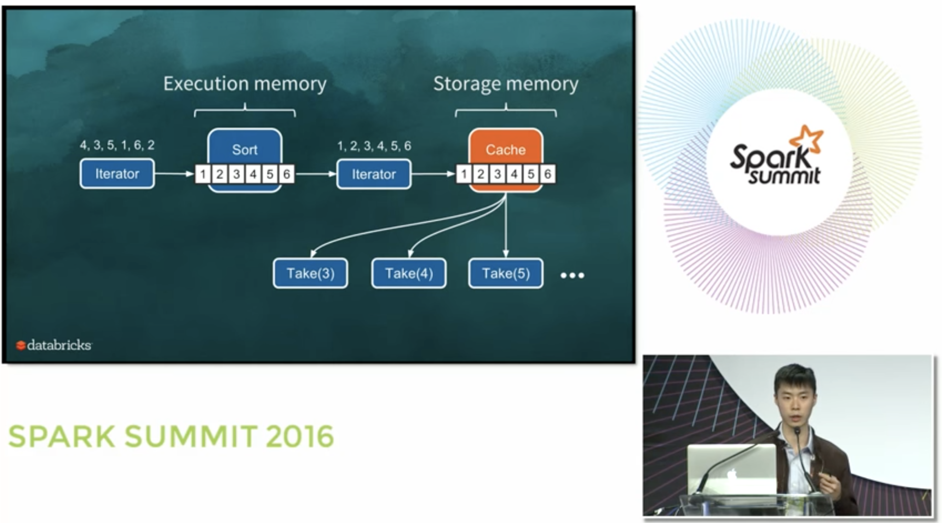
Executor’s memory and shuffle service
Deep Dive: Apache Spark Memory Management: https://www.youtube.com/watch?v=dPHrykZL8Cg

Slide 12
Executor’s memory and shuffle service
During map and shuffle operations, Spark writes to and reads from the local disk’s shuffle files
Heavy I/O activity
Results in a bottleneck
Default configurations are suboptimal for large-scale Spark jobs.
Knowing what configurations to tweak can mitigate this risk during this phase of a Spark job
Tuning the shuffle service running on each executor can increase overall performance for large Spark workloads

Slide 13
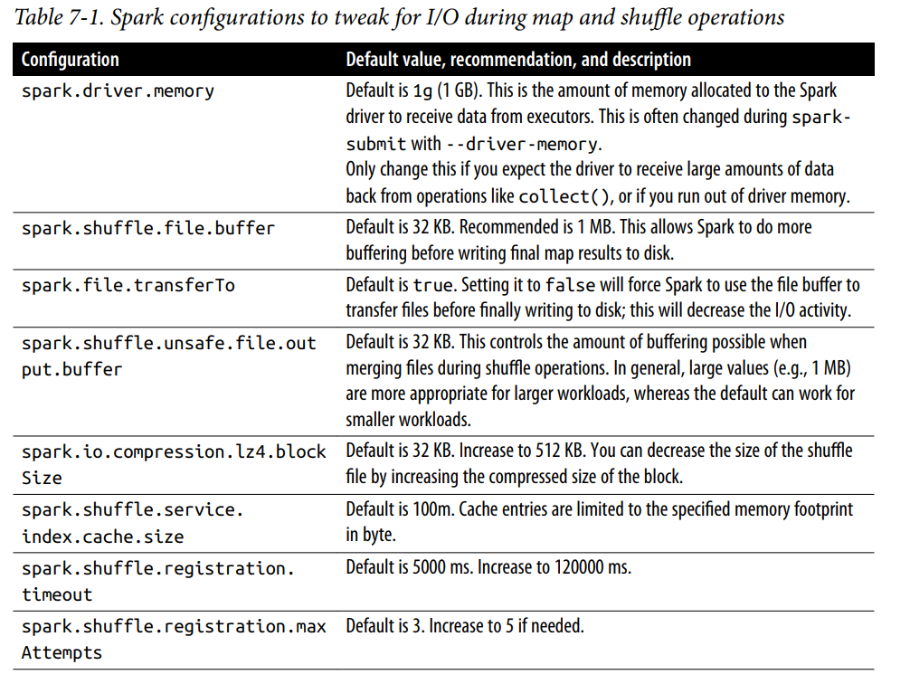
Executor’s memory and shuffle service

Slide 14
Maximizing Spark parallelism
Read and process as much data in parallel as possible
Need to understand how Spark reads data into memory from storage and what partitions mean to Spark
A partition is a way to arrange data into a subset of configurable and readable chunks or blocks of contiguous data on disk.
Partitions of data can be read or processed independently and in parallel by more than a single thread in a process
This allows for massive parallelism of data processing
In best scenario, Spark schedules a thread per task task per core, and each thread processes a distinct partition.
For optimizing resource utilization and maximum parallelism, ideally there are as many partitions as there are cores on the executor.

Slide 15
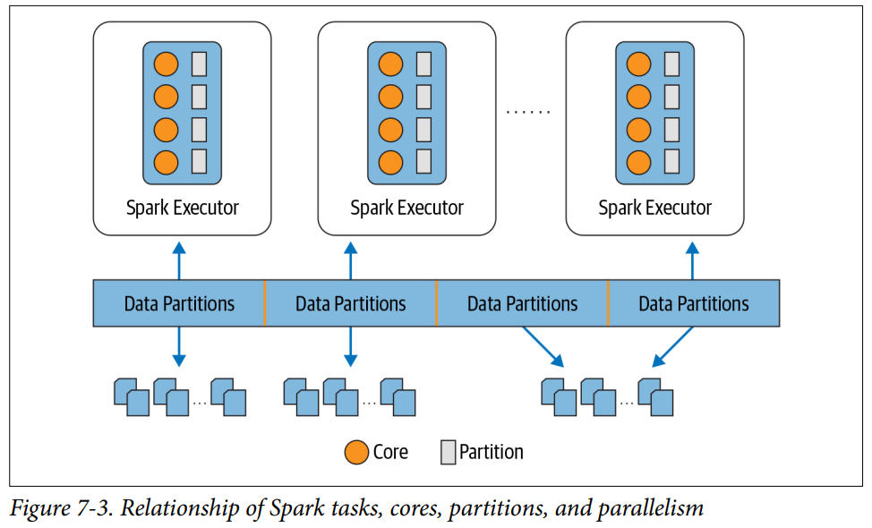
Maximizing Spark parallelism

Slide 16
Maximizing Spark parallelism
Spark’s tasks process data as partitions read from disk into memory.
Data on disk is laid out in chunks or contiguous file blocks (depending on the store)
By default: file blocks on data stores range in size from 64 MB to 128 MB. (e.g. HDFS and S3 have default size of 128 MB)
The file block size is configurable
A contiguous collection of the blocks constitute a partition.
The size of a partition in Spark is dictated by spark.sql.files.maxPartitionBytes (default 128 MB).
Decreasing the size can cause “small file problem” caused by file system operations (opening, closing, listing directories) which on a distributed system can be slow.

Slide 17
Shuffle Partitions
Partitions are also created explicitly when certain methods of the DataFrame API are used.
When creating a large DataFrame or reading a large file from disk, Spark can be instructed to create a certain number of partitions. e.g repartition(16)
During operations like groupBy() or join(), known as wide transformations
The shuffle spills results to executor’s local disks (spark.local.directory).
Shuffle partitions are created during the shuffle stage.
By default, the number of shuffle partitions is set to 200 (spark.sql.shuffle.partitions). This parameter can be adjusted depending on the size of the data set to reduce the amount of small partitions being sent across the network to executor’s tasks.
The default value for spark.sql.shuffle.partitions is too high for smaller or streaming workloads. Reduce it to a lower value (# of cores on the executors or less).
Shuffling partitions consume both network and disk I/O resources

Slide 18
Shuffle Partitions
No magic formula for the number of shuffle partitions to set for the shuffle stage
The number may vary depending on:
Use case
Data set
Number of cores
The amount of executor memory available
This is a trial-and-error approach
Consider caching or persisting frequently accessed DataFrames or tables.

Slide 19
Caching and Persisting Data
cache() and persist() are synonymous in Spark
persist() provides more control over how and where the data is stored (in memory/disk, serialized/unserialized).
DataFrame.cache()
Store as many of the partitions read in memory across Spark executors as memory allows
DataFrames may be fractionally cached. Partitions cannot be fractionally cached
E.g. If there are 8 partitions, and the memory has space for only 4.5 partition, then only. 4 partitions will be cached.
If not all partitions cached, the partitions that are not cached will have to be recomputed when accessed, causing slow down on the Spark job

Slide 20
Caching and Persisting Data
// In Scala
// Create a DataFrame with 10M records
val df = spark.
range(1 * 10000000).
toDF("id").
withColumn("square", $"id" * $"id")
df.cache() // Cache the data
df.count() // Materialize the cache
res3: Long = 10000000
Command took 5.11 seconds
df.count() // Now get it from the cache
res4: Long = 10000000
Command took 0.44 seconds
DataFrame is not fully cached until you invoke an action that goes through every record (e.g., count()).
Action like take(1) will cache only one partition because Catalyst realizes that you do not need to compute all the partitions just to retrieve one record.

Slide 21
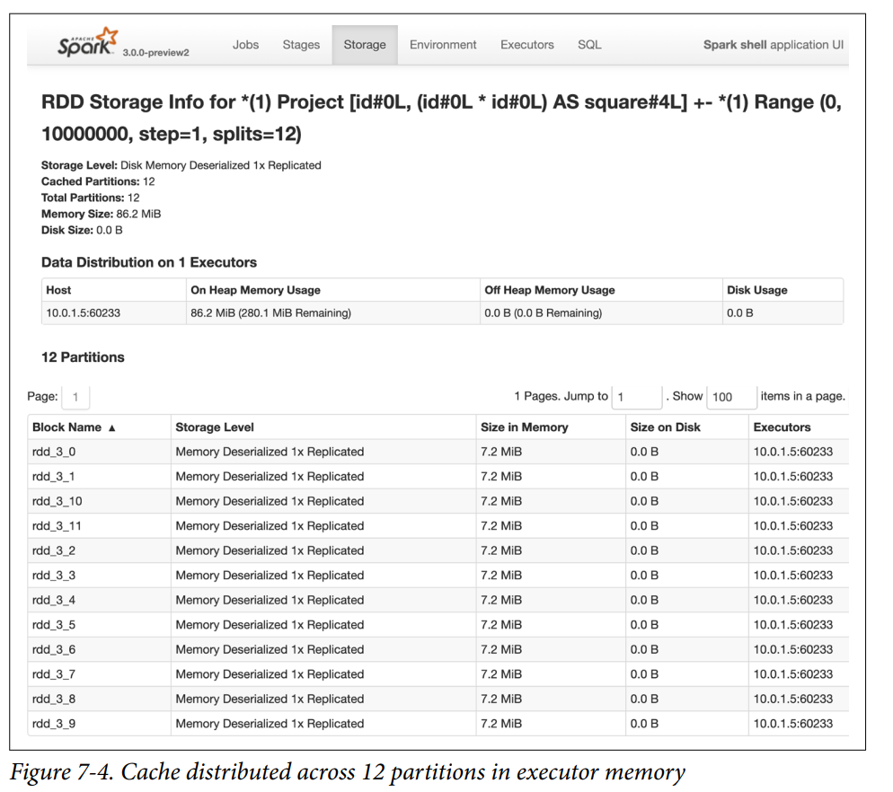

Slide 22
Caching and Persisting Data
DataFrame.persist()
Provides more control over how and where the data is stored (memory/disk, serialized/unserialized)
persist(StorageLevel.LEVEL)

Slide 23
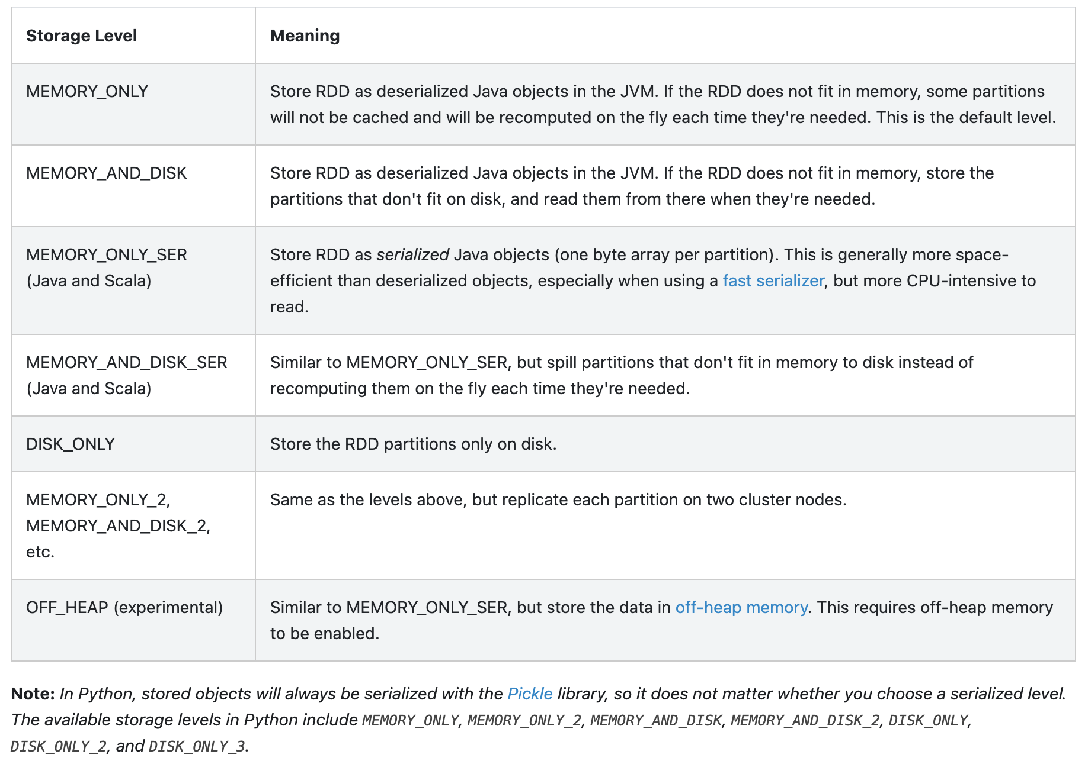
Caching and Persisting Data
https://spark.apache.org/docs/latest/rdd-programming-guide.html#rdd-persistence

Slide 24
Caching and Persisting Data
DataFrame.persist(StorageLevel.LEVEL)
Provides more control over how and where the data is stored (memory/disk, serialized/unserialized)
Each StorageLevel (except OFF_HEAP) has an equivalent LEVEL_NAME_2.
Replicate twice on different Spark executors.
Cons: can be expensive
Pros: allows data locality in two places
Provides fault tolerance
Gives Spark the option to schedule a task local to a copy of the data.

Slide 25
Caching and Persisting Data
Tables and views derived from DataFrames can also be cached.
df.createOrReplaceTempView("dfTable")
spark.sql("CACHE TABLE dfTable")

Slide 26
When to Cache and Persist
When to cache and persist
Accessing a large data set repeatedly
DataFrames commonly used during iterative machine learning training
DataFrames commonly accessed for doing frequent transformations during ETL or building data pipelines
When not to cache and persist
DataFrames that are too big to fit in memory
An inexpensive transformation on a DataFrame not requiring frequent use, regardless of size
General Rule
Use memory caching judiciously
Can incur resource costs in serializing and deserializing (depends on the StorageLevel used)

Slide 27
Data Serialization
Serialization plays an important role in the performance of distributed application. It has a direct impact on the speed of computation.
Spark provides two serialization libraries:
Java serialization: By default, Spark serializes objects using Java’s ObjectOutputStream framework. Java serialization is slower and results in large serialized formats for many classes.
Kryo serialization: Significantly faster and more compact than Java serialization (often as much as 10x)
Does not support all Serializable types.

Slide 28
Data Serialization
Switch to using Kryo by initializing your job with a SparkConf and calling conf.set("spark.serializer", "org.apache.spark.serializer.KryoSerializer").
This setting configures the serializer used for not only shuffling data between worker nodes but also when serializing RDDs to disk.

Slide 29
Family of Spark Joins
Need to be mindful of join operations that trigger expensive movement of data
Increased demand on compute and network resources from the cluster
Re-organizing data can alleviate data movement
Join operations are a common type of transformation
Spark SQL offers join transformations
inner joins, outer joins, left joins, outer joins, etc.
All of the join operations trigger a large amount of data movement across Spark executors

Slide 30
Family of Spark Joins
During join transformations, Spark computes
What data to produce
What keys and associated data to write to the disk
How to transfer those keys and data to nodes as part of operations like groupBy(), join(), agg(), sortBy(), and reduceByKey(); referred to as the shuffle.
Spark’s five distinct join strategies for exchanging, moving, sorting, grouping, and merging data across executors:
broadcast hash join (BHJ), shuffle hash join (SHJ), shuffle sort merge join (SMJ), broadcast nested loop join (BNLJ) and shuffle-and-replicate nested loop join (Cartesian product join)
BHJ and SMJ are most common ones

Slide 31
Family of Spark Joins - BHJ
Broadcast Hash Join
Also known as a map-side-only join.
Employed when two data sets need to be joined over certain conditions or columns:
One small data set fitting in the driver’s and executors memory
Another large enough data set that can be spared from movement
Using a Spark broadcast variable, the smaller data set is broadcasted by the driver to all Spark executors which is joined with the larger data set on each executor
By default Spark uses BHJ if the smaller data set is less than 10 MB (configured via spark.sql.autoBroadcastJoinThreshold)
Common use case: when there is a common key between two DataFrames

Slide 32
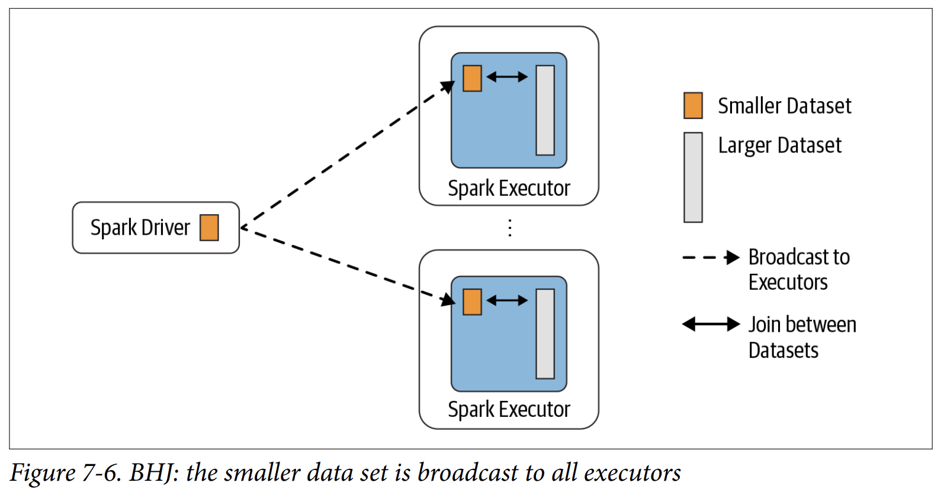
Family of Spark Joins - BHJ

Slide 33
Family of Spark Joins - BHJ
// In Scala
import org.apache.spark.sql.functions.broadcast
val joinedDF = playersDF.join(broadcast(clubsDF),
"key1 === key2")
Code above forces Spark to do a broadcast join.
It will resort to this type of join by default if the size of the smaller data set is below the spark.sql.autoBroadcastJoinThreshold.
BHJ is the easiest and fastest join.
Does not involve any shuffle of the data set
All the data is available locally to the executor after a broadcast
Need to make sure that there is enough memory on the driver and the executors.

Slide 34
Family of Spark Joins - BHJ
Use BHJ when
Each key within the smaller and larger data sets is hashed to the same partition by Spark
One data set is much smaller than the other (and within the default config of 10 MB, or more if you have sufficient memory)
You only want to perform an equi-join, to combine two data sets based on matching unsorted keys
You are not worried by excessive network bandwidth usage or OOM errors, because the smaller data set will be broadcast to all Spark executors
Note: Specifying a value of -1 in spark.sql.autoBroadcastJoinThreshold will cause Spark to always resort to a shuffle sort merge join,

Slide 35
Family of Spark Joins - SMJ
The sort-merge (or Shuffle Sort Merge Join) algorithm is an efficient way to merge two large data sets over a common key that is sortable, unique, and can be assigned to or stored in the same partition (two data sets with a common hashable key that ends up being on the same partition).
All rows within each data set with the same key are hashed on the same partition on the same executor.
This requires data to be collocated or exchanged between executors.
Has two phases:
Sort phase – Sorts each data set by its desired join key.
Merge phase – Iterates over each key in the row from each data set and merges rows if two keys match
By default, the SortMergeJoin is enabled via spark.sql.join.preferSortMergeJoin.

Slide 36
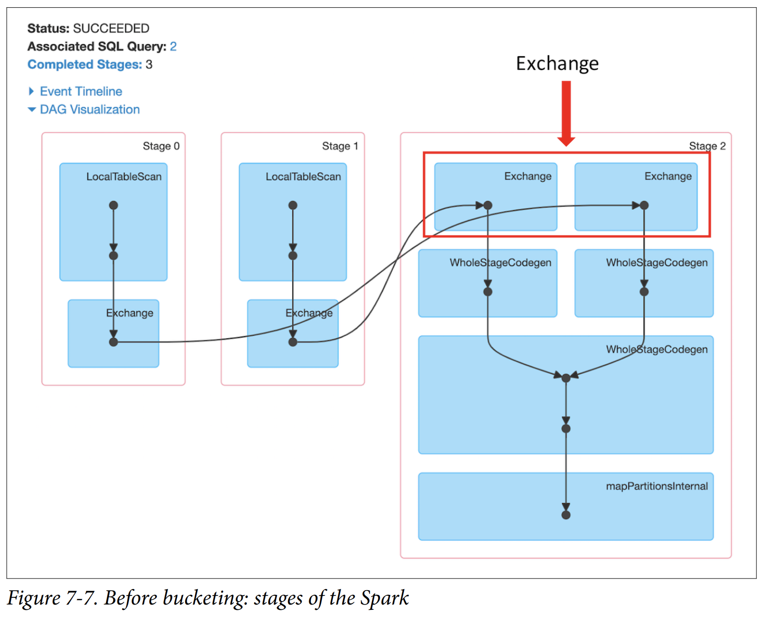
Family of Spark Joins - SMJ
The Exchange is expensive and requires partitions to be shuffled across the network between executors.

Slide 37
Family of Spark Joins - SMJ
Optimizing the shuffle sort merge join
Within SMJ, the Exchange (shuffle) step can be eliminated
Create partitioned buckets for common sorted keys or columns on which to perform frequent equi-joins.
Explicit number of buckets can be created to store specific sorted columns (one key per bucket).
Presorting and reorganizing data in this way can boost performance.

Slide 38
Family of Spark Joins - SMJ
import org.apache.spark.sql.functions._
import org.apache.spark.sql.SaveMode
// Save as managed tables by bucketing them in Parquet format
usersDF.orderBy(asc("uid"))
.write.format("parquet")
.bucketBy(8, "uid")
.mode(SaveMode.OverWrite)
.saveAsTable("UsersTbl")
ordersDF.orderBy(asc("users_id"))
.write.format("parquet")
.bucketBy(8, "users_id")
.mode(SaveMode.OverWrite)
.saveAsTable("OrdersTbl")
spark.sql("CACHE TABLE UsersTbl")
spark.sql("CACHE TABLE OrdersTbl")
val usersBucketDF = spark.table("UsersTbl")
val ordersBucketDF = spark.table("OrdersTbl")
val joinUsersOrdersBucketDF = ordersBucketDF
.join(usersBucketDF, $"users_id" === $"uid")
joinUsersOrdersBucketDF.show(false)

Slide 39
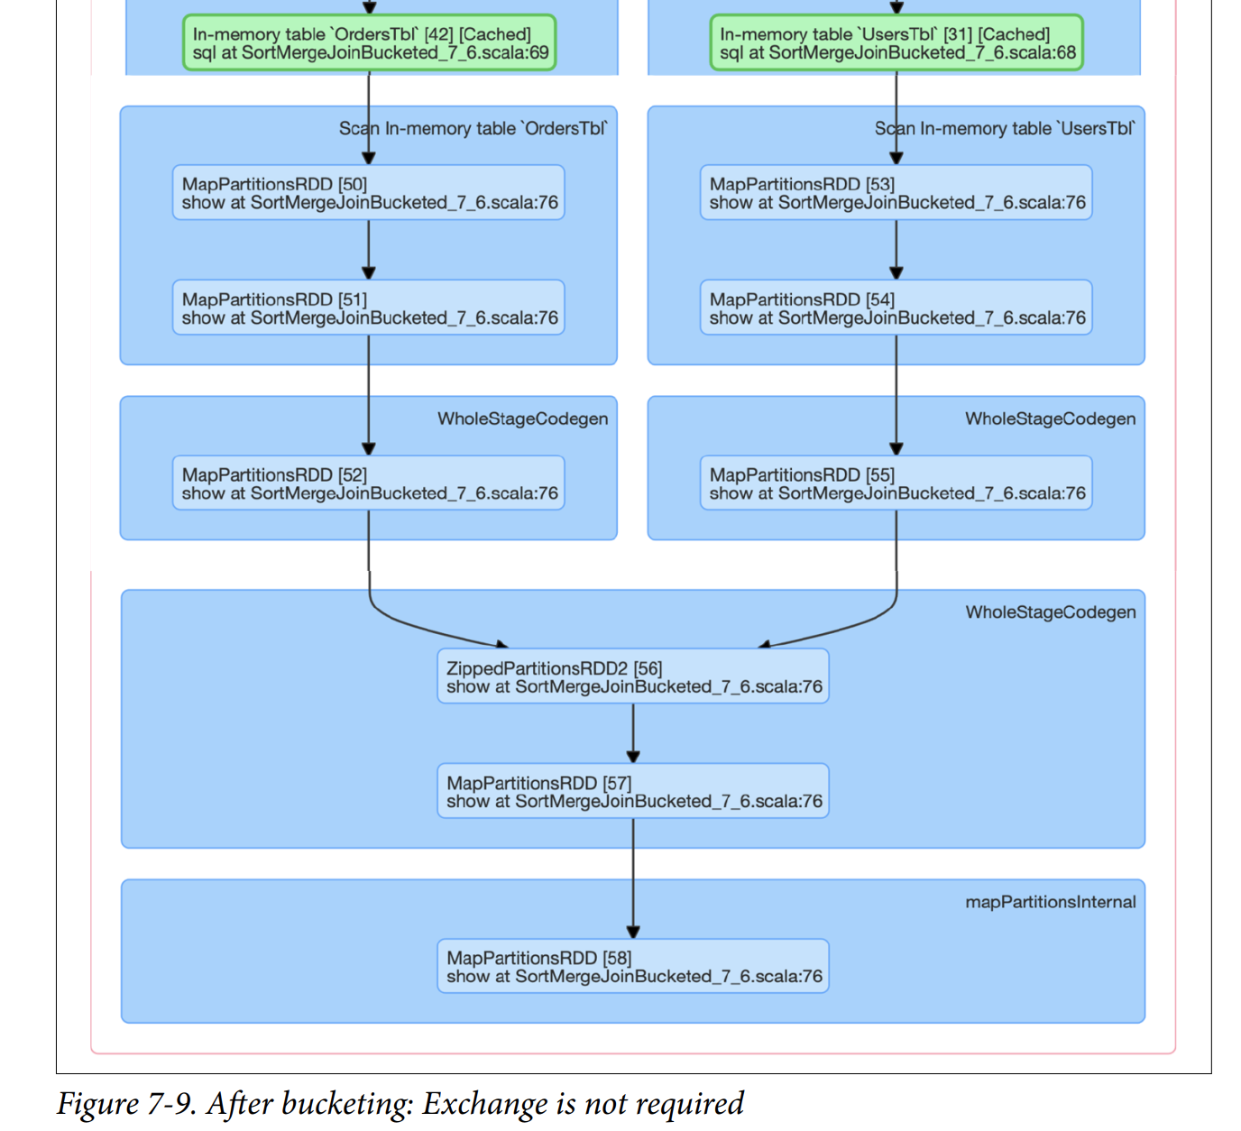
Family of Spark Joins - SMJ

Slide 40
Family of Spark Joins - SMJ
When to use a shuffle sort merge join
When each key within two large data sets can be sorted and hashed to the same partition by Spark
When there is a need to perform only equi-joins to combine two data sets based on matching sorted keys
When Exchange and Sort operations which cause large shuffles across the network need to be prevented.

Slide 41
Inspecting the Spark UI
https://spark.apache.org/docs/3.0.1/web-ui.html

Slide 42
Further Reading
Tuning Apache Spark for Large Scale Workloads: https://www.youtube.com/watch?v=5dga0UT4RI8
Hive Bucketing in Apache Spark: https://www.youtube.com/watch?v=6BD-Vv-ViBw&=645s
Spark + Parquet In Depth: https://www.youtube.com/watch?v=_0Wpwj_gvzg
Why You Should Care about Data Layout in the Filesystem: https://databricks.com/session/why-you-should-care-about-data-layout-in-the-filesystem
Deep Dive: Apache Spark Memory Management: https://www.youtube.com/watch?v=dPHrykZL8Cg
Decoding Memory in Spark: https://medium.com/walmartglobaltech/decoding-memory-in-spark-parameters-that-are-often-confused-c11be7488a24
Bucketing in Spark SQL 2.3: https://databricks.com/session/bucketing-in-spark-sql-2-3
Bucketing 2.0: Improve Spark SQL Performance by Removing Shuffle: https://databricks.com/session_na20/bucketing-2-0-improve-spark-sql-performance-by-removing-shuffle
The Parquet Format and Performance Optimization Opportunities: https://www.youtube.com/watch?v=1j8SdS7s_NY

Slide 43
Lots of Links
https://spark.apache.org/docs/latest/configuration.html#dynamic-allocation
https://spark.apache.org/docs/latest/job-scheduling.html#dynamic-resource-allocation
https://towardsdatascience.com/how-does-facebook-tune-apache-spark-for-large-scale-workloads-3238ddda0830
https://docs.databricks.com/delta/data-transformation/index.html
https://databricks.com/session/which-data-broke-my-code-inspecting-spark-transformations
https://databricks.com/session/why-you-should-care-about-data-layout-in-the-filesystem
https://mungingdata.com/apache-spark/partitionby/
https://0x0fff.com/spark-memory-management/
https://dzone.com/articles/accumulator-vs-broadcast-variables-in-spark
https://jaceklaskowski.gitbooks.io/mastering-spark-sql/content/spark-sql-bucketing.html
https://www.slideshare.net/databricks/bucketing-20-improve-spark-sql-performance-by-removing-shuffle
https://www.youtube.com/watch?v=6BD-Vv-ViBw
https://spark.apache.org/docs/latest/tuning.html
https://spark.apache.org/docs/latest/configuration.html

Slide 44

Questions

